Slide 1
#851-22-000107-PLNG Appeal of Conditional Use
#851-21-000416-PLNG
April 25, 2022 Board of County Commissioners

Slide 2
REQUEST
Appellant: Lisa Macy-Baker
Applicant: Oregon Treehouse Partners LLC
19-site Recreational Campground
Approximately 18-acres Rural Residential 2-Acre (RR-2) zoned land
Approximately 58.51-acre Parcel, remainder zoned Small Farm and Woodlot (SFW-20)

Slide 3
PLANNING COMMISSIONS DECISION
Planning Commission voted unanimously (7) in favor and (0) opposed to approved request.
Based upon findings of fact and conclusions on the record, including the staff report, public comments, written and oral testimony, and evidence presented.

Slide 4
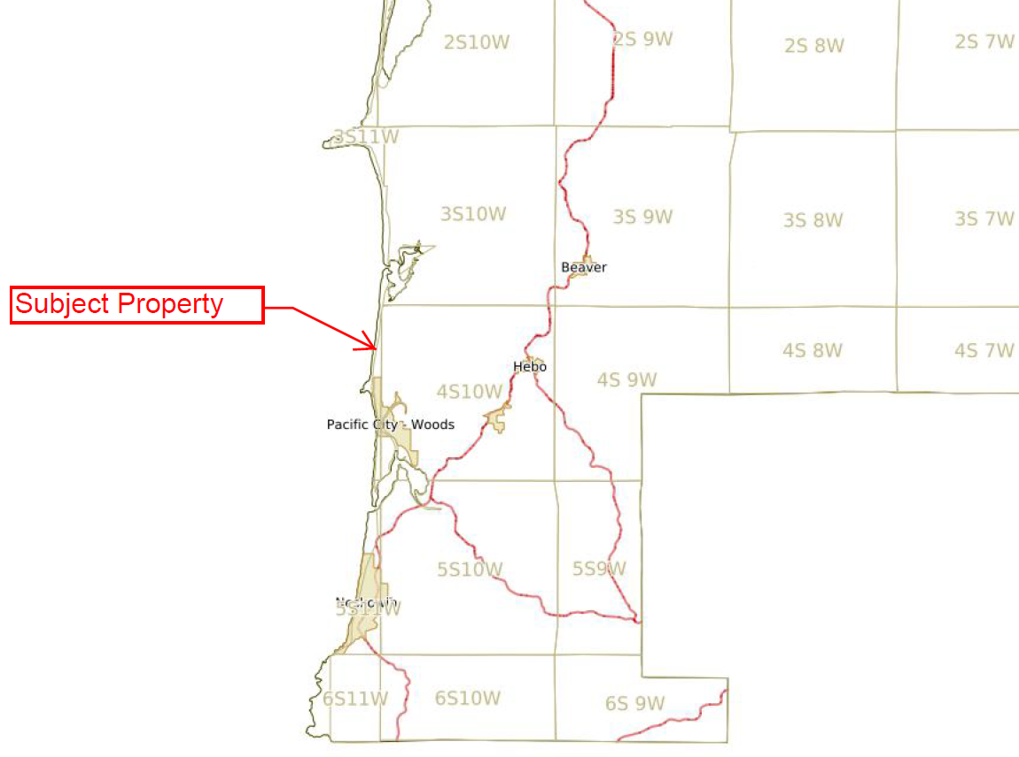
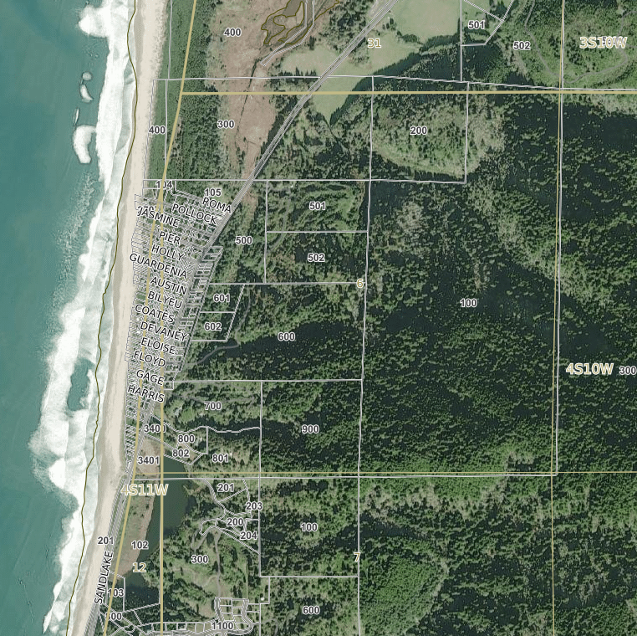
Vicinity Maps

Slide 5
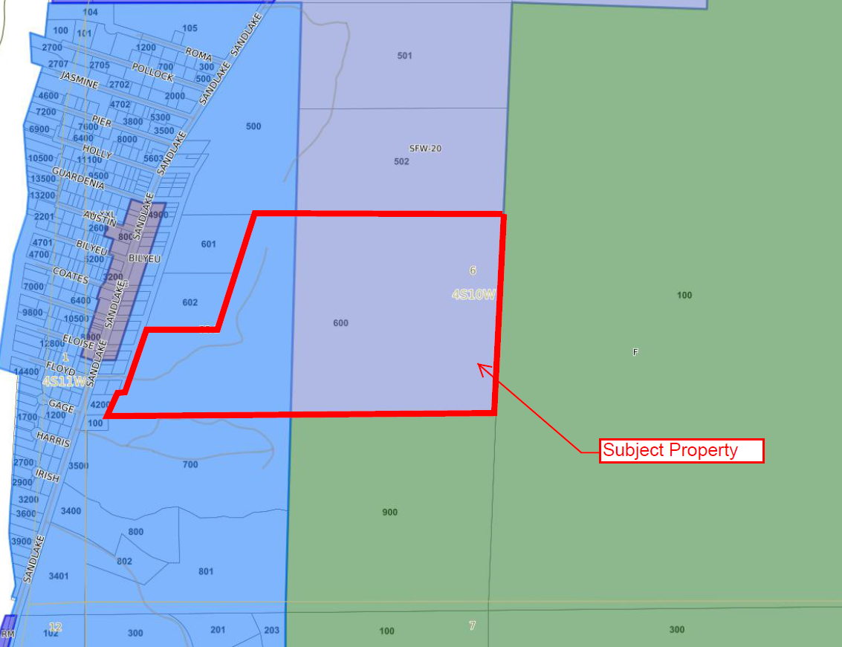
Zoning Map

Slide 6
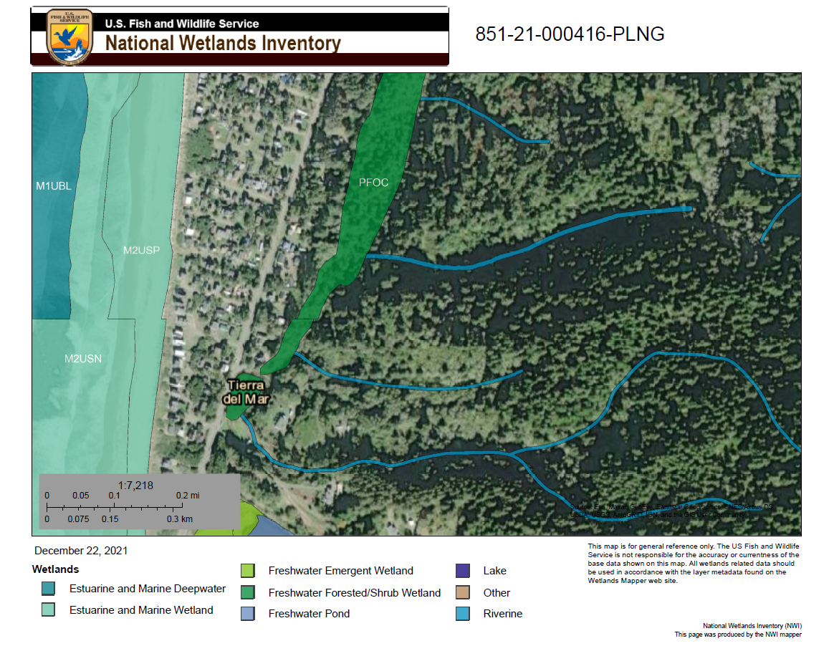

Property Maps

Slide 7
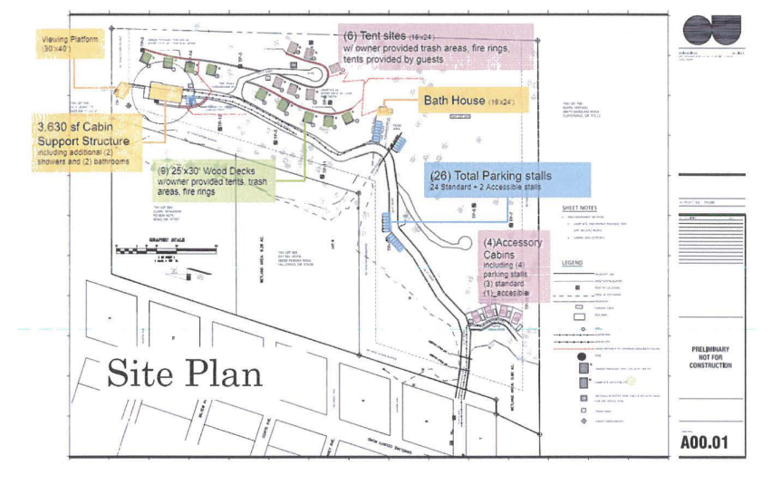
Site Plan provided by the Applicant

Slide 8
APPELLANTS BASIS FOR APPEAL
Planning Commission failed to adequately address criteria.
Appellant notes primary concerns regarding criteria 3, 4 & 6.
  Geologic Hazard Area assessment
  Wetlands and groundwater impacts
  Water availability & drinking water
  Emergency response and infrastructure limited for a timely use

Slide 9
PUBLIC COMMENTS
Primary concerns provided by the public include:
Traffic and pedestrian impacts, such as parking and influx of tourists to the area
Trash and health safety concerns
Emergency service response
Water service availability
Noise generation due to facilities and tourists

Slide 10
APPLICABLE PROVISIONS
TCLUO Section 3.010 – Rural Residential 2-Acre Zone (RR-2)
TCLUO Section 5.030: Recreational Campgrounds Standards
TCLUO Section 3.555: Freshwater Wetlands Overlay
TCLUO Section 4.130: Development Requirements for Geologic Hazard Areas
TCLUO Section 4.140: Requirements for Protection of Water Quality and Streambank Stabilization

Slide 11
CONDITIONAL USE REVIEW CRITERIA
(1) The use is listed as a CONDITIONAL USE in the underlying zone, or in an applicable overlying zone.
(2) The use is consistent with the applicable goals and policies of the Comprehensive Plan.
(3) The parcel is suitable for the proposed use considering its size, shape, location, topography, existence of improvements and natural features.
(4) The proposed use will not alter the character of the surrounding area in a manner which substantially limits, impairs or prevents the use of surrounding properties for the permitted uses listed in the underlying zone.
(5) The proposed use will not have detrimental effect on existing solar energy systems, wind energy conversion systems or wind mills.
(6) The proposed use is timely, considering the adequacy of public facilities and services existing or planned for the area affected by the use

Slide 12
CONDITIONS OF APPROVAL
The applicant/property owner shall obtain all required Federal, State, and Local permits and/or licenses and will comply with applicable rules and regulations.
The property owner shall obtain all necessary electrical, mechanical, and plumbing permits.
At the time of applying for Zoning and Building Permit approval, Applicant will be required to submit the following:
  Authorization Notice approval for on-site sewage disposal permits from the Department of Community Development or Oregon DEQ.
  A letter from Tierra Del Mar Water Company confirming water service to the proposed facility.
  A letter from the Nestucca Rural Fire Protection District confirming fire protection service to the proposed facilities.
  A letter from the Tillamook County Public Works Department approving the road approach and internal roadway design.
  Demonstration of compliance with the standards contained in TCLUO 4.130(2).
If buildings within or near the area identified as inactive landslide topography are to be sited on slopes greater than 29%, a Geologic Hazard Report will be required as described in TCLUO 4.130. If such a report is required, a Geologic Hazard Report shall be submitted in conjunctions with application for Zoning and Building Permit approval for review and acceptance.

Slide 13
CONDITIONS OF APPROVAL (CONT.)
Applicant will maintain the minimum proposed vegetative buffers between the proposed area of development and the property boundaries. The site plan submitted for approval with application for Zoning and Building permits will clearly show the vegetative buffers.
Development will comply with the requirements and standards of TCLUO 3.010 ‘Rural Residential 2-Acre (RR-2) Zone’ and 5.030 ‘Recreational Campground Standards’.
Overnight temporary use of the campground by a camper or a camper’s vehicle shall not be for longer than six (6) months in any twelve (12) month period as required by TCLUO Section 5.030.
The applicant/property owner shall provide a copy of an approved campground design from Tillamook County Environmental Health at time of Zoning Permit/Building Permit submittal.
Development shall comply with riparian buffer and vegetation retention requirements of TCLUO Section 4.140: Requirements for Protection of Water Quality and Streambank Stabilization.
Signage shall comply with the requirements of TCLUO Section 4.020: Signs.
Development shall occur in the area as generally depicted on the submitted site plan and as described and shall not exceed 19 campsites and the supporting facilities, including the support cabin and bathhouse.

